Slide 1


Tools for Shared Decision-Making Conversations
Dr Ellen Lowry
Norwich Medical School
e.lowry@uea.ac.uk

Slide 2



Consultation Skills Theme
Norwich Medical School

Slide 3
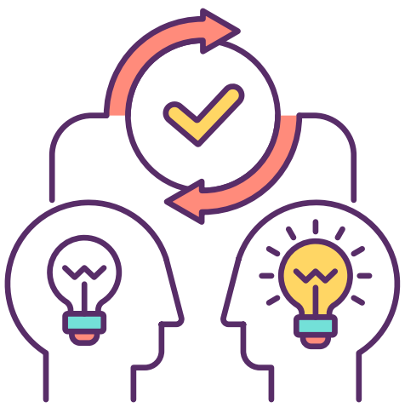
What & Why?
Importance in Med Ed – GMC Outcomes For Graduates
NHS Long Term Plan, Personalised Care ‘expanded the choices and control that people have over their own care’
NICE Guidelines (Consensus statement), No decision about me, without me (Coulter & Collins, 2011)
Health & Social Care Act, 2012 ‘reasonable care to ensure that the patient is aware of any material risks involved in any recommended treatment and of any reasonable alternative or variant treatments’ …
Shared decision-making is a collaborative process that involves a person and their healthcare professional working together to reach a joint decision about care - NICE

Slide 4

Barriers to Shared Decision-Making
What our students were telling us:
Unclear how to structure consultations
Difficulty discussing benefits & risks
Requesting more guidance
Lower pass mark for SDM than other process skills tested in year 3
Barriers & Facilitators to implementing SDM (Alsulamy et al., 2020):
Lack of tools & resources
Lack of patient choice/ or lack of explicit choices
Not explaining treatment options & outcomes
Using jargon & complex terminology
Discuss sufficient options and outcomes
Use decision support tools
Share responsibility –giving explicit permission to participate
Notes:
Some background, I joined the school in 2022, and it became apparent to me that our students were really struggling with the concept of SDM.
Big step up for our student from information giving to taking a more collaborative approach
This is supported by the literature, - we know that there are systemic issues at play in terms of workload, time institutional pressures, quality of the patient-doctor relationship

Slide 5

Our response
Short-term support: Remediation in year 3 for SDM – read about our approach here How reflective remediation can set medical students up for success | THE Campus Learn, Share, Connect
Long-term support: Reviewed teaching methods & introduce B.R.A.I.N. mnemonic a structured framework to support conversations in SDM
Building on the Three Talk model (Elwyn et al., 2012) -Choice, Options, Decision as a conceptual framework
Notes:
So, we took a 2 pronged approach – immediate and long-term approach
For the immediate term, we put remediation in place
For the longer term, decided we needed a change in approach and introduced a new framework for helping structure these consultations
Introduced the BRAIN framework

Slide 6

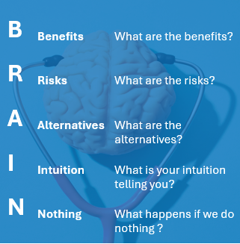

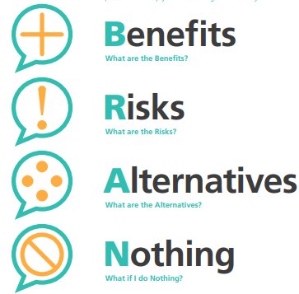
B.R.A.I.N for Shared Decision-Making
https://icea.org/wp-content/uploads/2015/12/ICEA-Informed-Decision-Making-Worksheet.pdf
Notes:
1. Choosing Wisely started in the US (2012) and is part of a global campaign aimed at improving conversations between patients and their healthcare professionals – originally aimed at improving patient involvement and reducing the use of unnecessary tests, treatments and procedures
2. Choosing Wisely UK was launched in 2016, but is now primarily focused on shared decision making. Using BRAN to encourage patients to get the best from their consultations by asking 4 questions – what are the benefits , what are the risks, what are the alternatives, what if I do nothing?
3. B.R.A.I.N version developed by International Childbirth Education Association & Patient Voices Network as tool to make informed decisions and discuss birth options – two-way tool for patient & clinician use
4. Introduction of intuition to try and better understand your own feelings around birthing options / care

Slide 7

Benefits
What are the benefits for the patient?
How will this treatment help their symptoms?
Risks
What are the risk of treatment?
How might the treatment affect the person's life?
What risks are we trying to prevent?
Alternatives
What are the other treatment options?
What treatment is typically used first?
Intuition
How does the person feel about these options?
What is important to them in making this decision?
Based on what the person has told you, is there an option that appear better suited to them?
Nothing
What would watchful waiting look like for this condition?
What will happen if the person decides to do nothing?
What risks are we trying to avoid?
B.R.A.I.N to aid students in SDM discussions
Notes:
Used these frameworks as a basis, and built in questions as an aid for students to structure their SDM conversations – tool to be applied from the doctor / student perspective to guide their consultations
Benefits – benefits to them as a patient- how it will it help their symptoms, what are the good parts of treatment – day procedure, local aesthetic, one tablet daily
Risks – risks to them of the treatment – side effects, surgical complications, will there be lasting implications, what are we trying to prevent in term of progressive symptoms
What are the other treatment options?
Intuition – where the students trying to elicit the patient’s perspectives – what's important to them

Slide 8
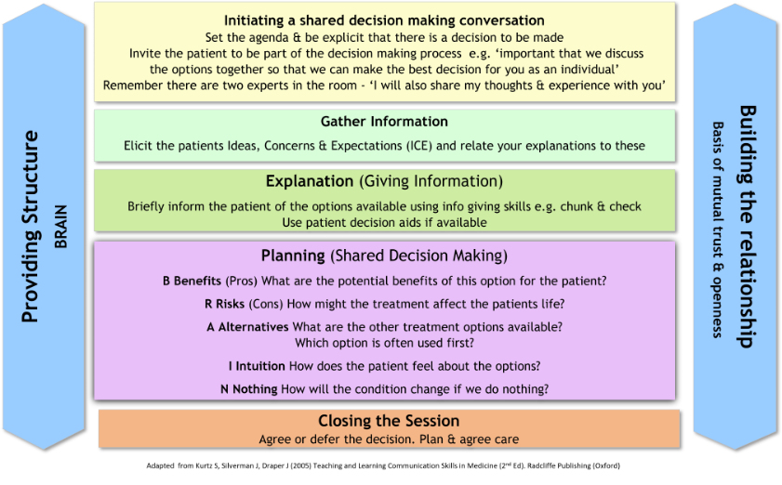
B.R.A.I.N & Calgary Cambridge Guide
Logical sequence
Actively Listening
Sign-posting
Understand the patient’s narrative
Summarising
Explore impact on biopsychosocial factors
Share your thinking
Pick up cues
Screening
Sensitivity and empathy
Adapted by Lowry & Winterburn (2023) from Kurtz, Silverman & Draper (2005), Teaching and Learning Communication Skills in Medicine (2nd Ed). Radcliffe Publishing, Oxford.
Notes:
Integrate this module into the Calgary Cambridge Guide – would expect our students to use the skills obtained from the first 2 years of teaching
Set the agenda – invite the patient to take part in the decision making
Gather the patient’s perspective using ICE – assess starting point
Explain the details of the treatment / condition
Begin the process of BRAIN
Skill spotting /applying these to support the conversation – provide structure
Building the relationship – you would expect to see skills used such as picking up on cues – patient starts to look anxious/ confused, integrating these skills throughout – educated guesses

Slide 9
B.R.A.I.N & Calgary Cambridge Guide
It is important we discuss your options together today, so we can make the best decision for you. Does that sound ok?
Have you given your treatment options much thought?
Is there anything you are concerned about or would like to raise before we discuss your options?
Is there anything you think might be helpful for us to discuss today?
We have discussed a lot of information. What are your thoughts so far? / do you have any questions? / any preferences? / anything I can go over again?
It is important you know what will happen if you choose to do nothing. If symptoms are experienced over a long period of time, stomach acid may damage your oesophagus and cause some further problems…
Do you know what is causing your symptoms? Gastro-oesophageal reflux disease (GORD) is a common condition, where acid from the stomach leaks up into the oesophagus…
Like you have experienced, common symptoms include…
An alternative to medication is making some lifestyle changes. Would you like to hear about these?
Eating smaller and more frequent meals, avoiding things that trigger symptoms…
Some common side effects include headache, diarrhoea and stomach pain. These tend to be mild but will go away when you stop taking the medicine
Serious side effects are rare, and happen in less than 1 in 1000 people, but if you experience… call a doctor or 111 straight away
The most common treatment for GORD is a PPI. They work by reducing the amount of acid your stomach makes.
It is a tablet that is taken once daily, people fin the morning works well
You should start to feel better in 2 to 3 days. For most people this is a well-tolerated…
How do you feel about that?
From what you have told me it sounds like… xxx, xxx is important to you and your preference would be to start…
From what you have told me it sounds like… xxx, xxx is important to you and your preference would be to start… is that correct?
If you are happy with that, we will…
Adapted by Lowry & Winterburn from Kurtz, Silverman & Draper (2005), Teaching and Learning Communication Skills in Medicine (2nd Ed). Radcliffe Publishing, Oxford.
Notes:
Integrate this module into the Calgary Cambridge Guide – would expect our students to use the skills obtained from the first 2 years of teaching
Set the agenda – invite the patient to take part in the decision making
Gather the patient’s perspective using ICE – assess starting point
Explain the details of the treatment / condition
Begin the process of BRAIN
Skill spotting /applying these to support the conversation – provide structure
Building the relationship – you would expect to see skills used such as picking up on cues – patient starts to look anxious/ confused, integrating these skills throughout – educated guesses

Slide 10
B.R.A.I.N & Calgary Cambridge Guide
Logical sequence
Actively Listening
Sign-posting
Understand the patient’s narrative
Summarising
Explore impact on biopsychosocial factors
Share your thinking
Pick up cues
Screening
Sensitivity and empathy
Adapted by Lowry & Winterburn from Kurtz, Silverman & Draper (2005), Teaching and Learning Communication Skills in Medicine (2nd Ed). Radcliffe Publishing, Oxford.
Notes:
Integrate this module into the Calgary Cambridge Guide – would expect our students to use the skills obtained from the first 2 years of teaching
Set the agenda – invite the patient to take part in the decision making
Gather the patient’s perspective using ICE – assess starting point
Explain the details of the treatment / condition
Begin the process of BRAIN
Skill spotting /applying these to support the conversation – provide structure
Building the relationship – you would expect to see skills used such as picking up on cues – patient starts to look anxious/ confused, integrating these skills throughout – educated guesses

Slide 11

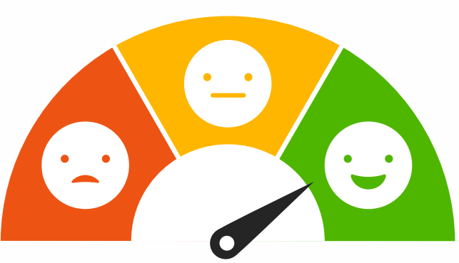
Measuring Impact
Aims
Evaluate Student, Simulated Patient & Tutor experience of implementing B.R.A.I.N.
Population
third year undergraduates with 23-24 & 25-25 cohorts so far (~440 students)
Mixed Methods Design
Student evaluation data (>850)
Simulated Patient survey
Tutor survey
SDM Assessment outcomes (2yrs pre-BRAIN/ 2yrs post-BRAIN)
Collaborators: Dr Susan Miles & Dr Sadie Lawes-Wickwar
Notes:
Thematic analysis

Slide 12

Making an Impact
National / international impact from students taking approach into clinical practice (~220 per year from NMS…)
Greater exploration of patient perspectives
Supporting personalised care

Slide 13
References
Alsulamy, N., Lee, A., Thokala, P., & Alessa, T. (2020). What influences the implementation of shared decision making: an umbrella review. Patient education and counseling, 103(12), 2400-2407.
Coulter, A., & Collins, A. (2011). Making shared decision-making a reality. London: King's Fund, 621.
Elwyn, G., Frosch, D., Thomson, R., Joseph-Williams, N., Lloyd, A., Kinnersley, P., ... & Barry, M. (2012). Shared decision making: a model for clinical practice. Journal of general internal medicine, 27, 1361-1367.
International Childbirth Education Association . Informed Decision-Making Worksheet. Accessed MARCH 23, 2025. https://icea.org/wp-content/uploads/2015/12/ICEA-Informed-Decision-Making-Worksheet.pdf
Kurtz, Silverman & Draper (2005), Teaching and Learning Communication Skills in Medicine (2nd Ed). Radcliffe Publishing, Oxford.
Leinweber J, Stramrood C. Improving birth experiences and provider interactions: Expert opinion on critical links in Maternity care. Eur J Midwifery. 2024 Sep 9;8. doi: 10.18332/ejm/191742. PMID: 39351401; PMCID: PMC11440052.
Shared decision-making: summary of NICE guidance. BMJ 2021; 373 doi: https://doi.org/10.1136/bmj.n1430 (Published 17 June 2021)Cite this as: BMJ 2021;373:n1430
https://www.nice.org.uk/about/what-we-do/our-programmes/nice-guidance/nice-guidelines/shared-decision-making
https://www.gmc-uk.org/education/standards-guidance-and-curricula/standards-and-outcomes/outcomes-for-graduates/outcomes-for-graduates/outcomes-2---professional-skills
https://www.aomrc.org.uk/projects-and-programmes/#choosing-wisely

Slide 14




Thank you
We would love to collaborate with fellow Medical Schools please speak to me or email e.lowry@uea.ac.uk

Slide 15
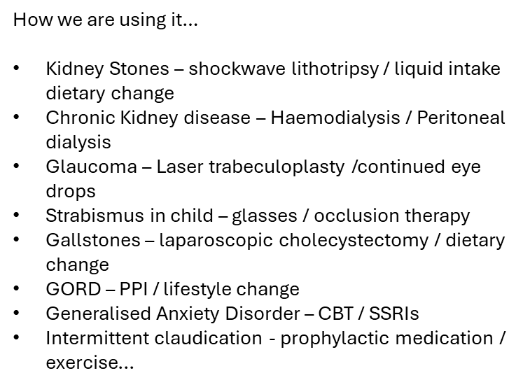

Slide 16
Example scenarios
GORD
You are a third-year medical student working in primary care. You have been asked by Dr Singh to speak to Stephanie/ Stephen Blake (48). Mrs/Mr Blake has come to the surgery to seek advice on heartburn. Use this role play to:
Practice Shared Decision Making (B.R.A.I.N) - Informing the patient that there is a choice to be made and how you would like them to be part of the decision-making process
Outline the available options by sharing information on the possible ways forward:
B. benefits (pros) of starting medication such as a proton pump inhibitor (PPI)
R. risks (cons) of starting medication (side effects; ability to tolerate PPI, underlying health conditions and possible interactions with other drugs)
Benefits and Risks should be discussed from a medical perspective (you the student provide this information) and from a patient perspective (how does the patient feel about these? What concerns or questions do they have about these?)
A. alternatives – advise patient to avoid known precipitants; smoking, alcohol, coffee, chocolate, fatty foods and being overweight. If applicable, offer lifestyle advice including advice on healthy eating, weight reduction and smoking cessation.
I. intuition – how does the patient feel about the options discussed? From what the patient has told you, is there an option that seems better suited to the patient?
N. nothing – explain that there is always the option of watchful waiting. How will the condition change if we do nothing? What would be involved in watchful wating for this condition?

